Slide 1
PHYS60022 Data Science and Machine Learning for Physics
Week 3: Discussion
Spring 2025

Slide 2
Correlation vs (in-)dependence
Recall, we defined the concept of covariance between two random variables X, Y in week 1,
From here, we can define correlation
We said that two random variables, X and Y, are independent if
→ Their joint distribution is the product of their marginal distributions

Slide 3
Correlation vs (in-)dependence
It is easy to show that if two random variables X, Y are independent, then ρ(X,Y) = 0
Note that for independence …
A

Slide 4
Correlation vs (in-)dependence
It is easy to show that if two random variables X, Y are independent, then ρ(X,Y) = 0
Note that for independence …
A
So
A
From we have that
Since
Then
and so too is the correlation

Slide 5
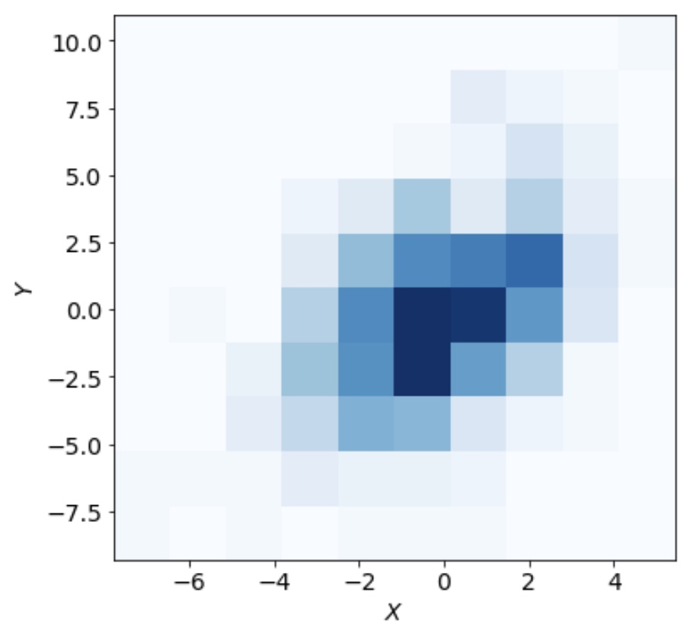
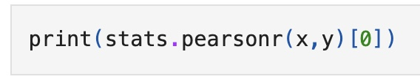

Correlation vs (in-)dependence
Suppose we do not know the dependence of the variables, Can we test for it?
In this case, we could estimate the correlation using the sample covariance
or in Python
The correlation is fairly significant

Slide 6
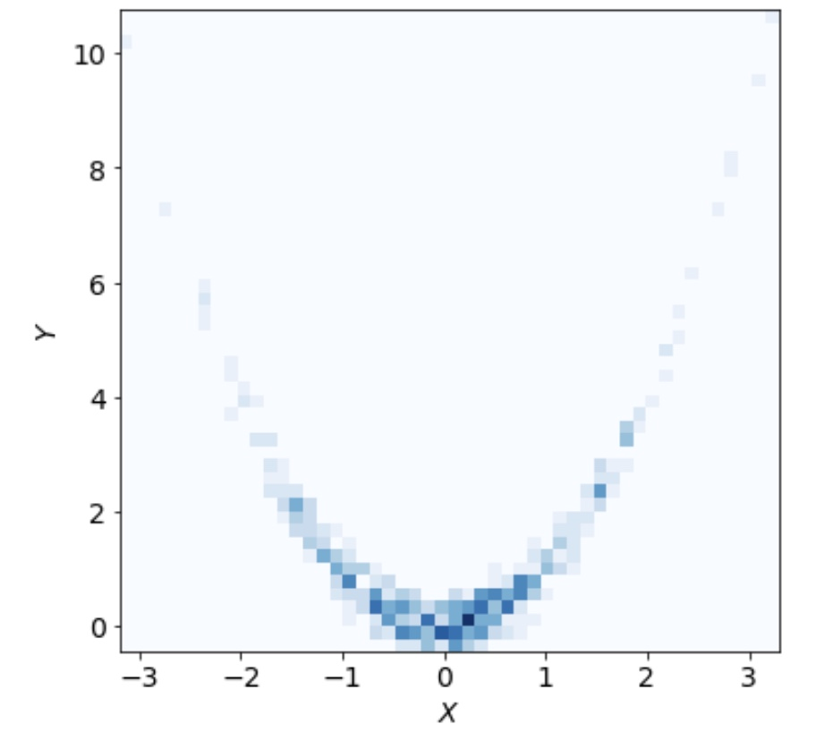

Correlation vs (in-)dependence
What about this case?
In this case, we could estimate the correlation using the sample covariance
or in Python
The correlation is close to zero!
Small correlation does not imply independence!

Slide 7
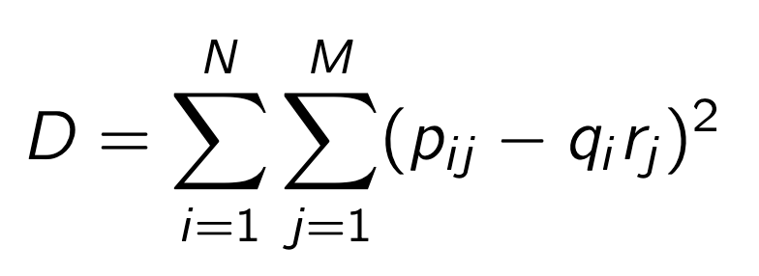
Tests of independence
In ML, there are many (much better) tests of independence. The U-statistic Permutation (USP) is a simple(ish) example
The USP is based on the divergence of binned distributions (sometimes referred to as tables)
r_{j}
j=N
p_{ij}
q_{i}
H₀ := X and Y independent ➔ D = 0
j=0
i=0
i=N

Slide 8
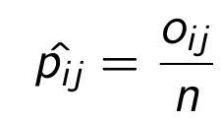
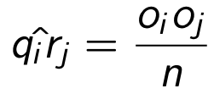
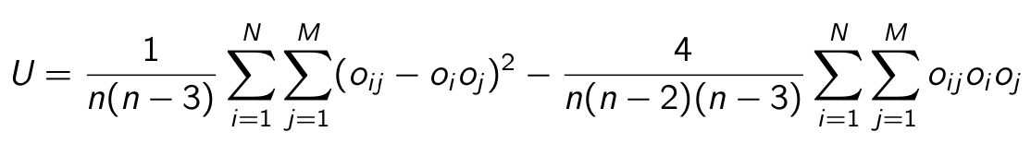
Tests of independence
In ML, there are many (much better) tests of independence. The U-statistic Permutation (USP) is a simple(ish) example
With only the observed data, we have good (unbiased) estimators for the densities p_{ij} and q_{i}r_{j}
r_{j}
j=N
O_{ij} and O_{i/j} are the observed number of events in the ij-th bin of the 2D histogram, and the i-th or j-th bin of each 1D histogram
p_{ij}
q_{i}
j=0
i=0
i=N
see
R. Soc. A 477: 20210549

Slide 9
Tests of independence
Estimating the distribution of U under the null hypothesis
The original data is {(X₁,Y₁), (X₂,Y₂),…,(X_{n},Y_{n})}
Generate a permutation σ of {1,…,n} and create a new dataset {(X₁,Y_{σ(1)}), (X₂,Y_{σ(2)}),…,(X_{n},Y_{σ(n)})}

Slide 10
Tests of independence
Estimating the distribution of U under the null hypothesis
The original data is {(X₁,Y₁), (X₂,Y₂),…,(X_{n},Y_{n})}
Generate a permutation σ of {1,…,n} and create a new dataset {(X₁,Y_{σ(1)}), (X₂,Y_{σ(2)}),…,(X_{n},Y_{σ(n)})}
Bin the data in the original histogram and calculate the test statistic U for this new dataset
Repeat a large number of times
In Python, we would use the resample package for all of this

Slide 11
Tests of independence
With the distribution of U, we can perform a hypothesis test
Clearly reject H₀ in this case

Slide 12
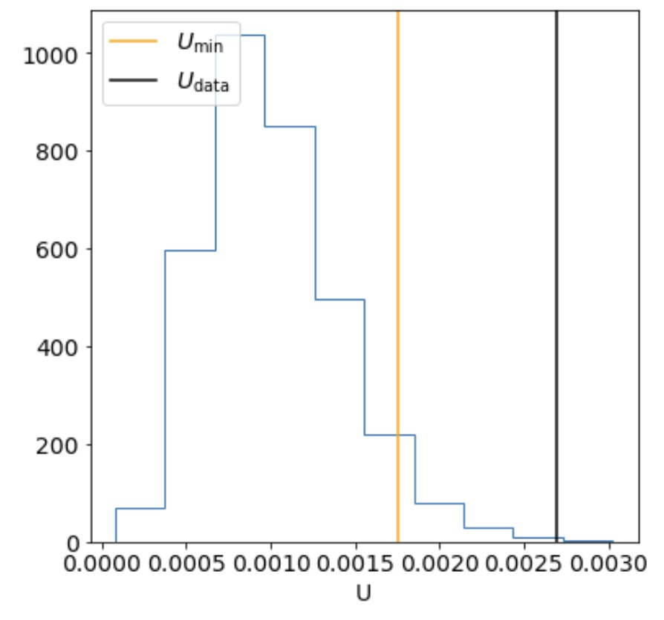
Tests of independence
With the distribution of U, we can perform a hypothesis test
Clearly reject H₀ in this case too

Slide 13
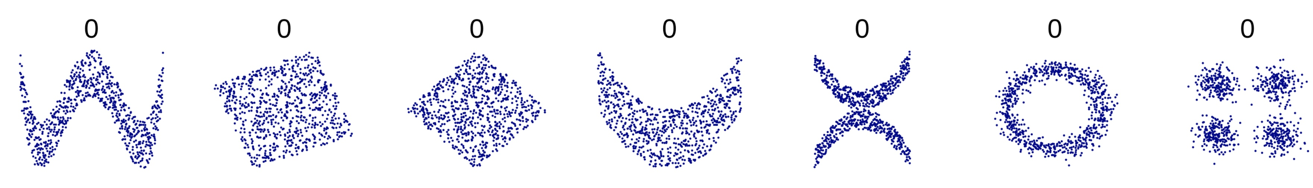
Correlation vs independence
ρ =
https://en.wikipedia.org/wiki/Correlation

